Slide 1

WASTE COLLECTION SENSOR SYSTEM
PRESENTATION
Submitted by: Rashmi Tripathi and Lava Kumar

Slide 2
Features
User can login as admin and user as well as guest
Admin can see historical data
Admin can see truck routes in tabular and map format
User can see condition of garbage bins around ones area
Guest users can only see the city garbage bins information

Slide 3
Algorithm
Check all bin filling rate
Calculate expected date it will be filled
Bins with fill rate between 90 and 100 should be prioritized on day 1
Bins with fill rate between 80 and 90 should be prioritized on day 2 based upon their distance to respective center
Bins below 50 should be prioritized on later days
Maps should show level 1,2,3,4 data

Slide 4
Tools and Technology
Front-End: Ionic framework, HTML5 and CSS
Back-End: JavaScript and Node.js
Database: https://data.kcmo.org/

Slide 5
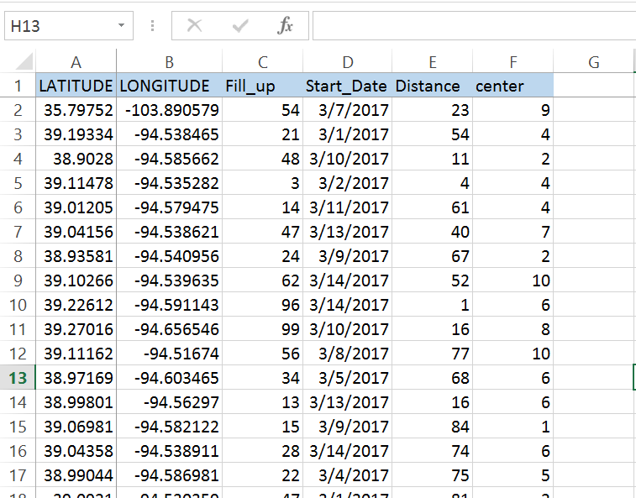
Sample Data

Slide 6
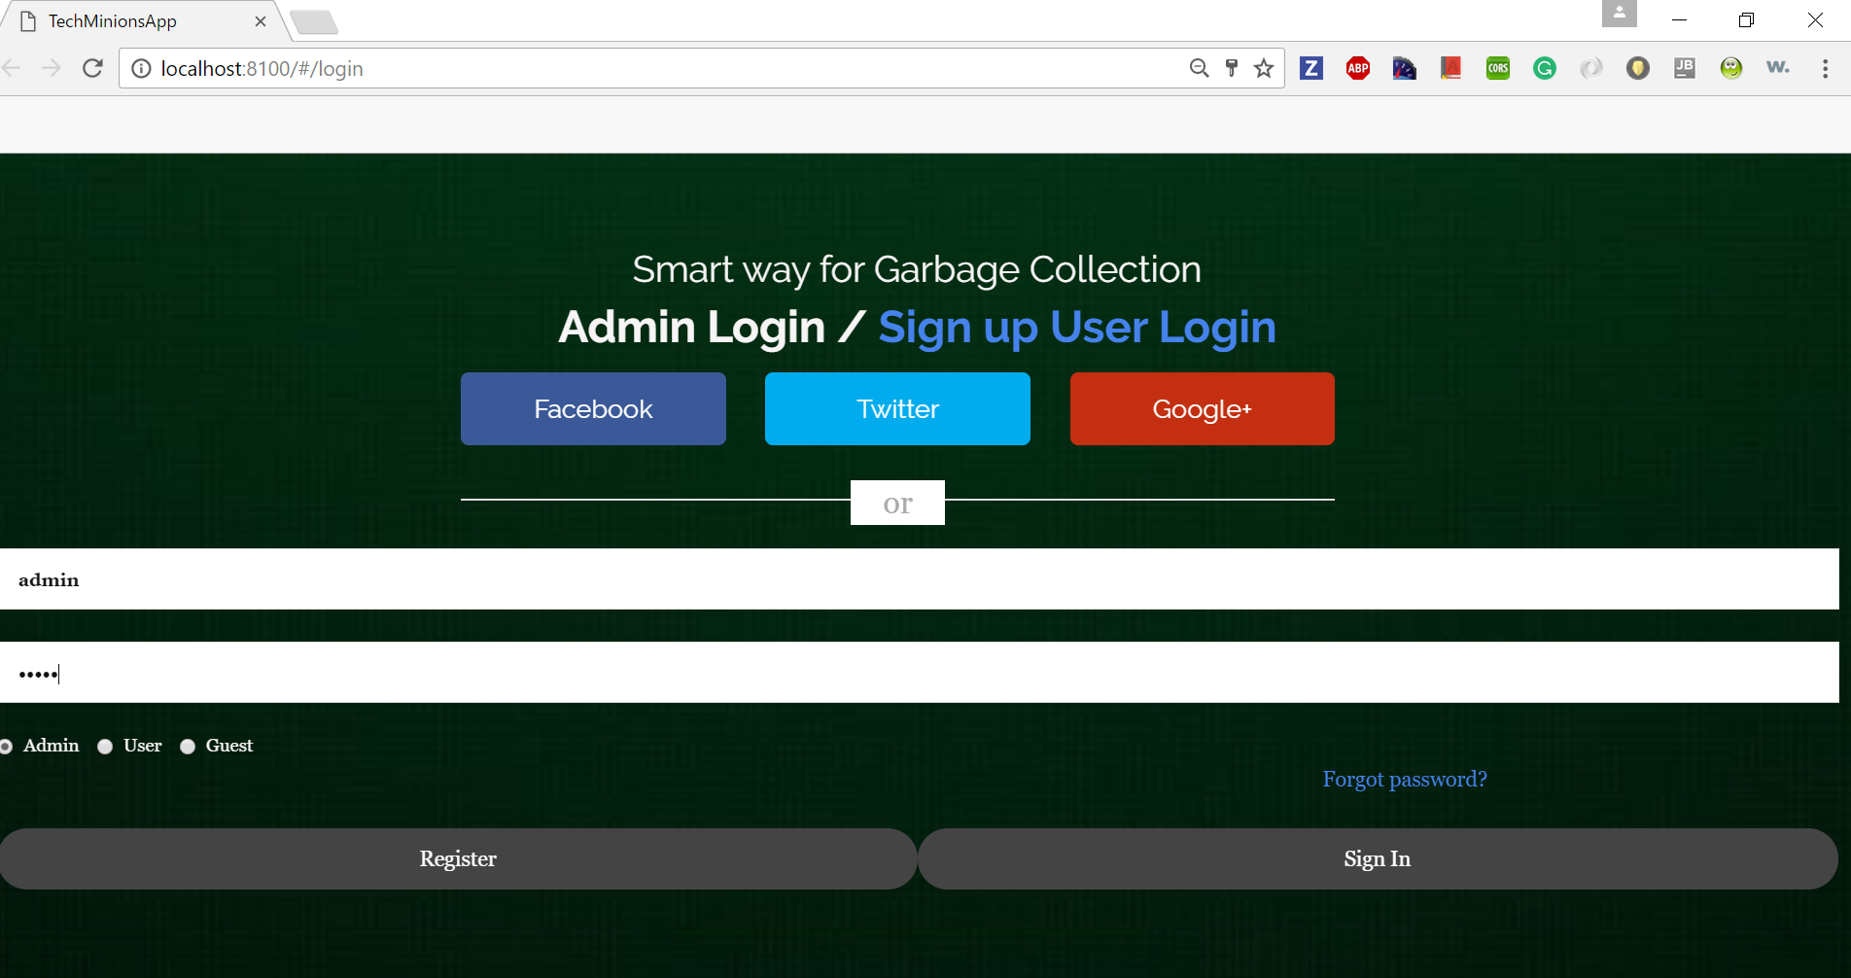
Login

Slide 7
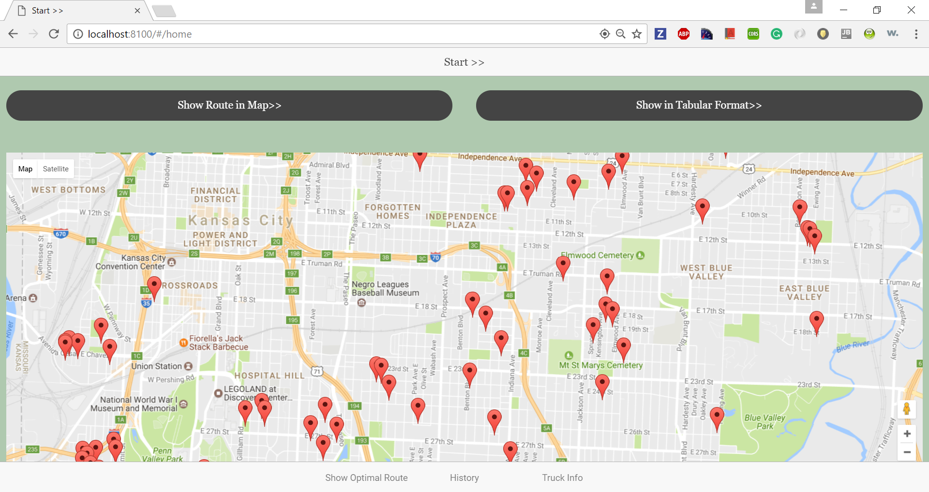
Home Screen

